Slide 1

TzimasK Rapid Games
March 2020 until October 2021
Presented by: Dimitris Kaisaris
Last updated: November 12th 2021

Slide 2

Table of Contents
Stats and Tips
Elo Graph and Win rates
Openings and Tips
What about Time Controls?
Link to Data Studio

Slide 3
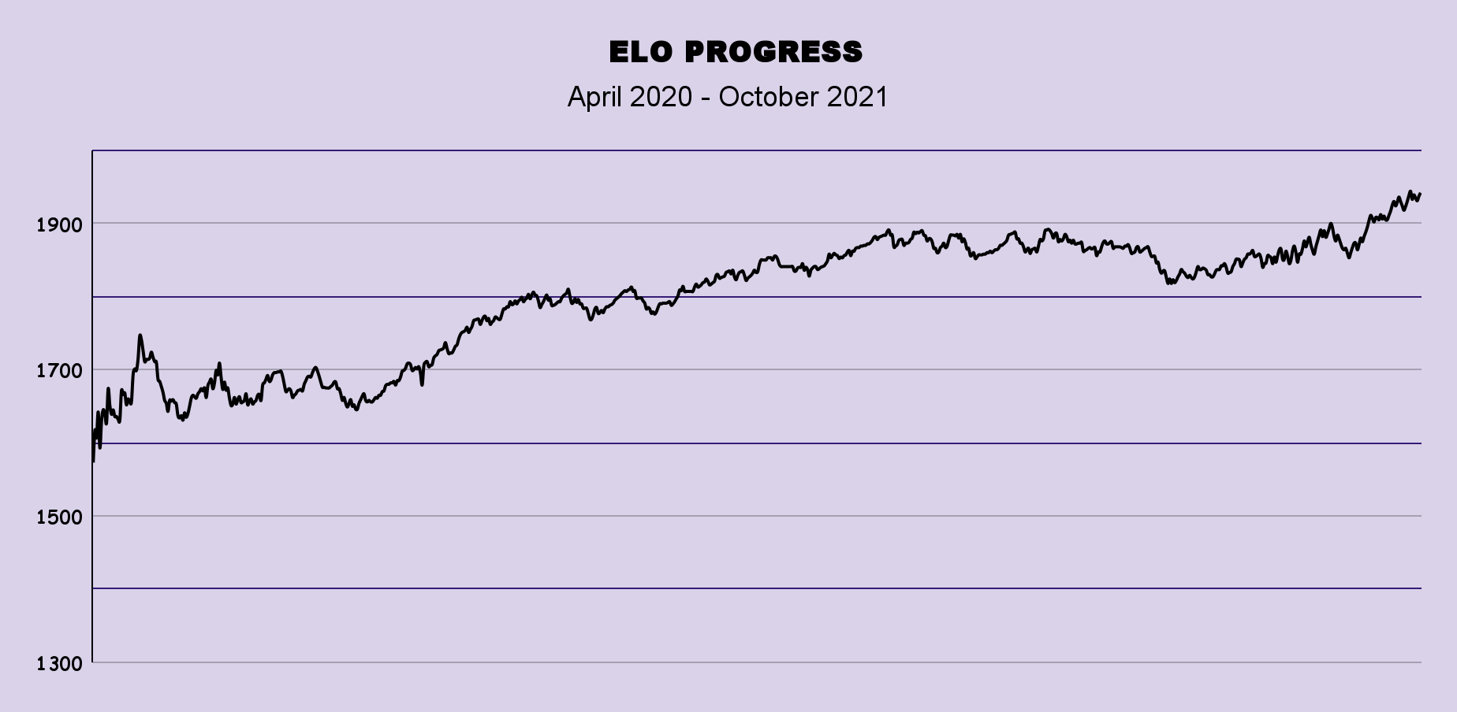
Elo Graph
Steady progress from the 1600-1800 to 1800-1950 Elo range in an 18 month period.
Very nice Job!
April 2020
January 2021
October 2021

Slide 4
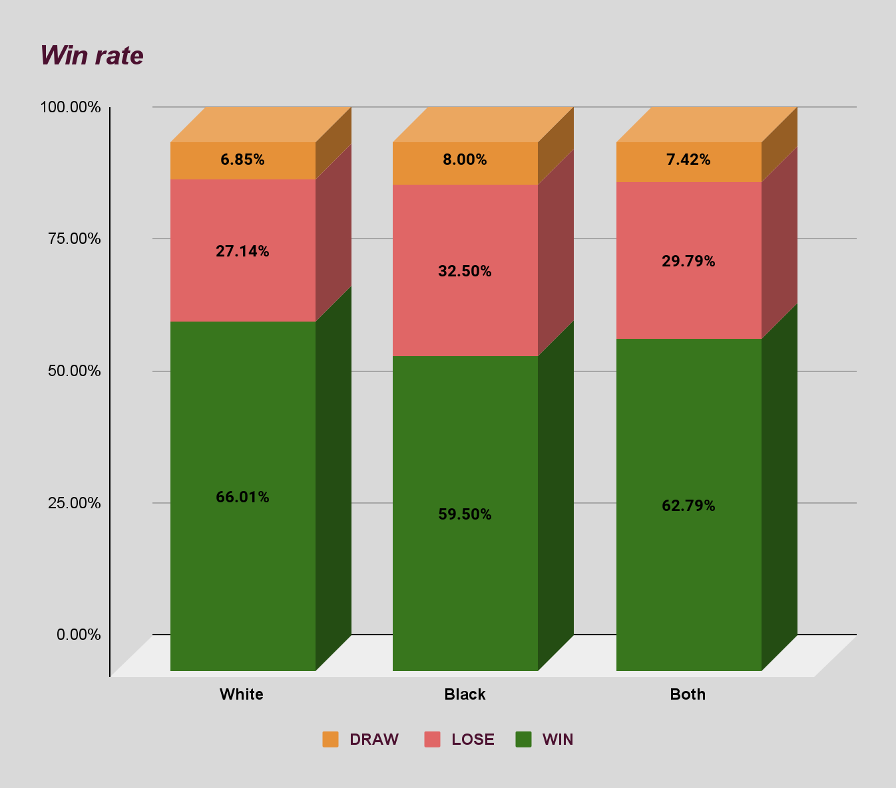
Win Rates
809 total rapid games
409 played as white
400 played as black
62.79% overall win rate! Bravo!
66% win rate with the white pieces. Pretty cool!
59.5% win rate with the black pieces. Good Job!

Slide 5
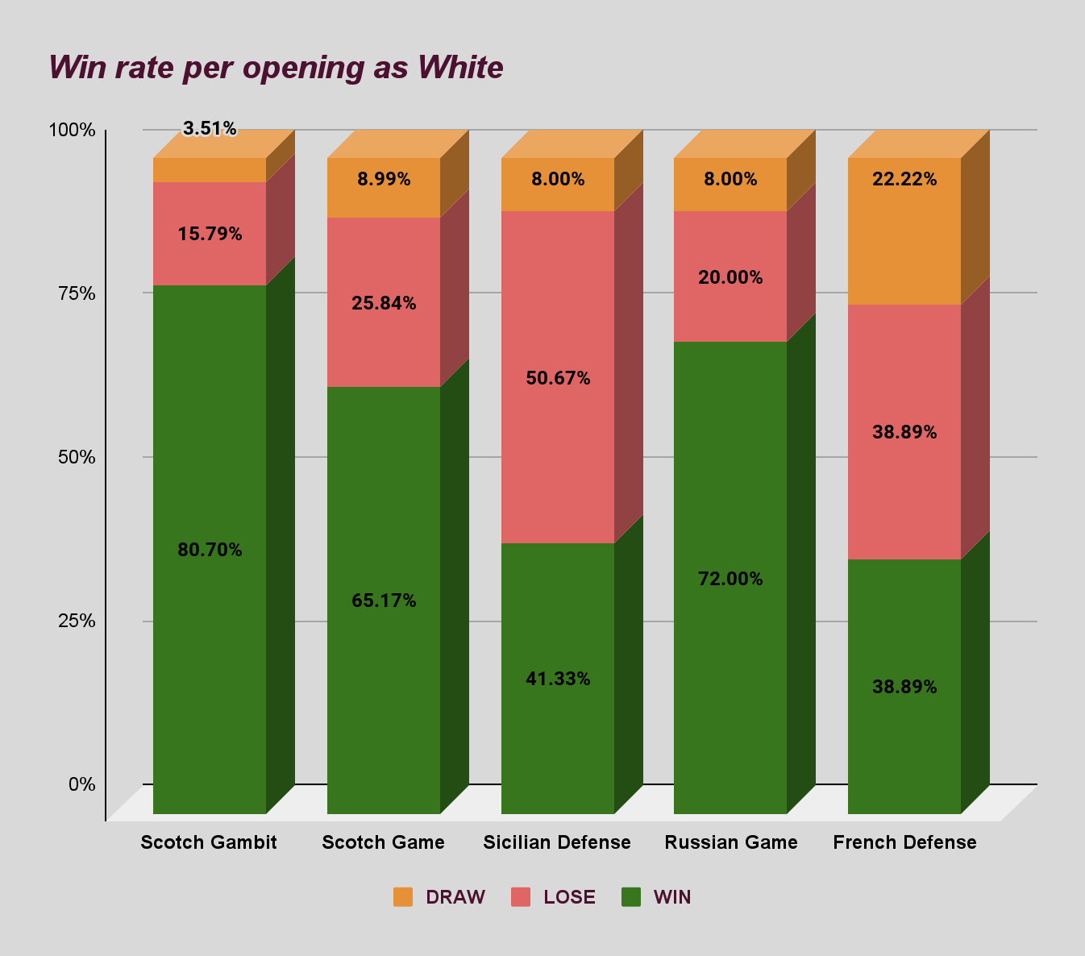
Most Played Openings as White
Oh no! Got some issues with Sicilian pizza?
Scotch Gambit (114 games)
Scotch Game (89 games)
Sicilian Defense (75)
Are you developing a special weapon?
Pretty impressive results with the Scotch Gambit. Use it in a must win situation!
It seems we have a hard time against the Sicilian. Study the game : “ Kasparov vs the World” and use this nice set up against the Sicilian!

Slide 6
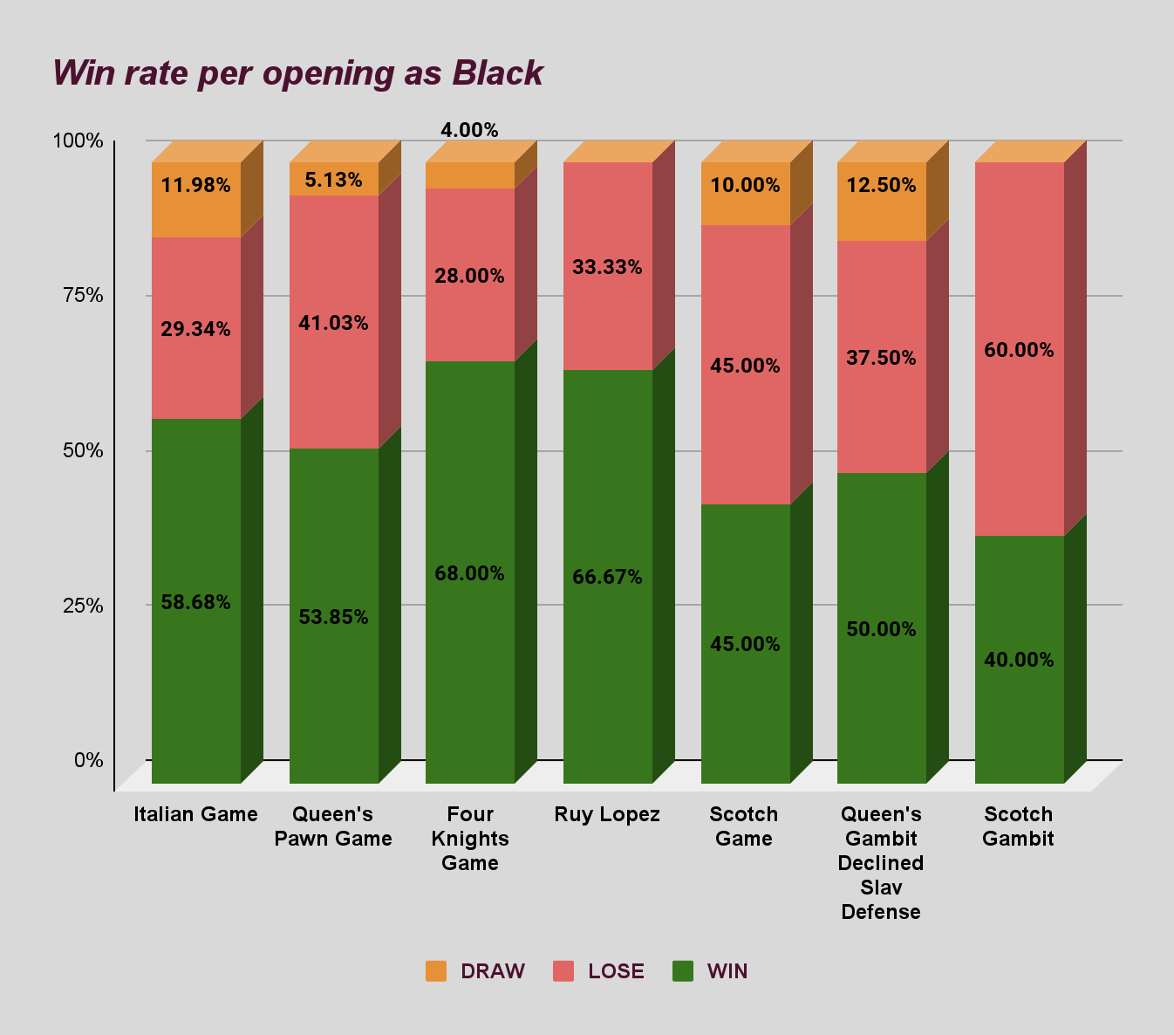
Most Played Openings as Black
Taste your own medicine?
Italian Game (167 games)
Queen's Pawn Game (39 games)
Four knight’s Game (25 games
Keep it up!
Continue studying and improving the Italian game! You face it most of the time!
It is hard to play against one’s favorite opening! Master the MAIN LINE against the Scotch variations to improve your play!

Slide 7
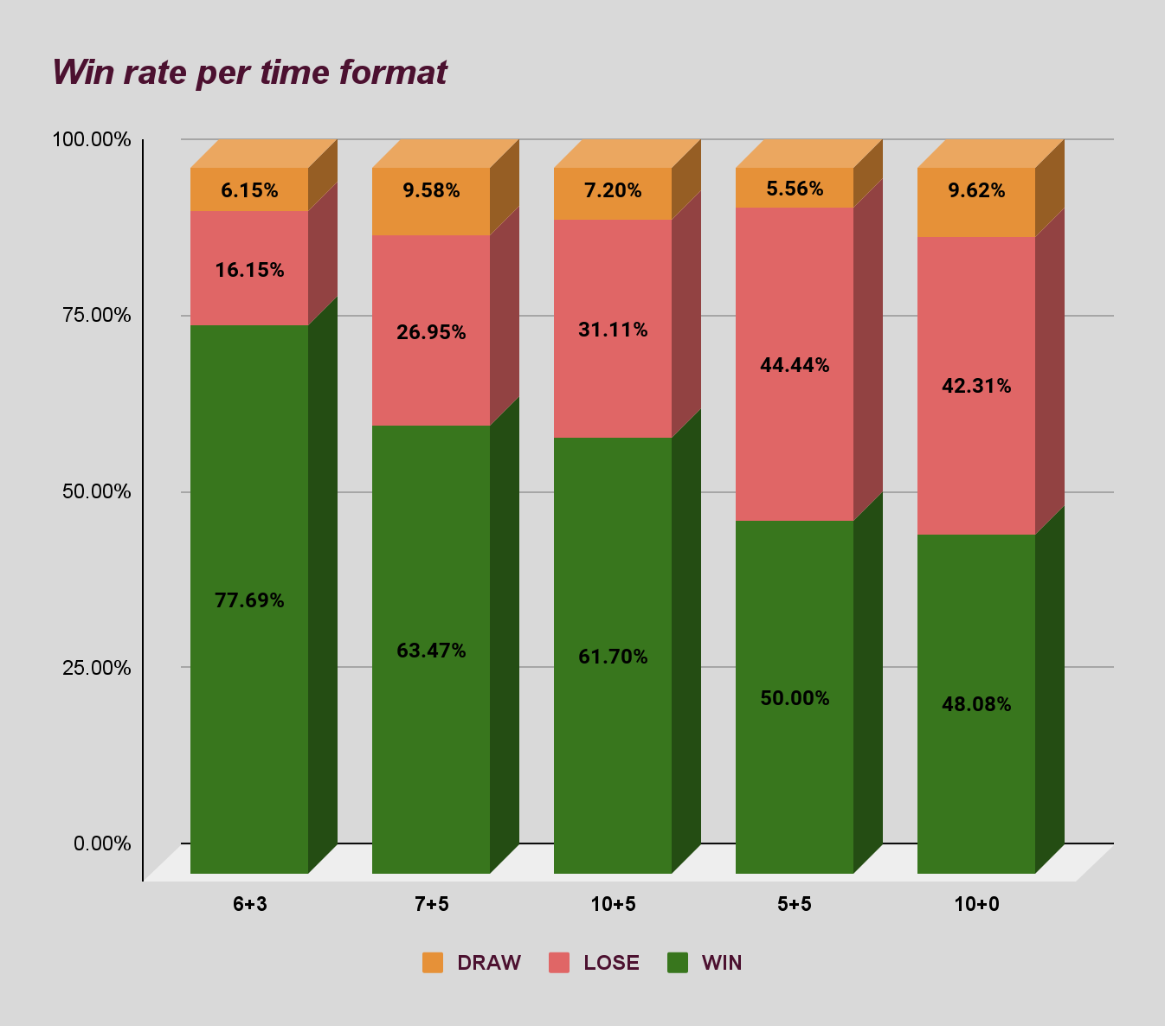
What about Time Controls?
10+5 (389 games)
7+5 (167 games)
6+3 (130 games)
10+0 (52 games)
5+5 (36 games)
After checking the average strength of your opponents per time format, here's some tips: 1) Play the 6+3 events to gain momentum and confidence. 2) Play 10+5 games to sharpen your skills. 3) DON'T play games WITHOUT time increment!
Avoid playing games without increment, like 10+0!
Focus on playing the first 3 Time Controls.

Slide 8
DataStudio Link
https://datastudio.google.com/reporting/ab756547-d965-45d4-8413-0c212b0b4f1e
Find your games using filters to search for specific dates, events, openings, sub variations and many other things!

Slide 9
THANK YOU !

